Slide 1
PROCEDURE FOR PAYMENT OF PROCESSING FEE
STATE LEVEL ENVIRONMENT IMPACT ASSESSMENT AUTHORITY (SEIAA)
RAJASTHAN

Slide 2
Background
The Ministry of Environment, Forest and Climate Change, Government of India, under Section 3(3) of the Environment Protection Act, 1986 and Notification S.O. 1533(E) dated 14th September 2006, constituted the State Level Environment Impact Assessment Authority (SEIAA) and State Level Expert Appraisal Committee (SEAC) to appraise and decide on Environmental Clearance applications.
The State Government has decided to levy a one-time processing fee for projects seeking Environmental Clearance (EC) from SEIAA, under EIA Notification S.O. 1533(E) dated 14.09.2006 and its amendments.

Slide 3
Category of Projects and Rates

Slide 4
(A) Construction Projects/Area Development Projects: -
S.No | Constructed Area or Development Area | Processing Fee (In Rs.)
1. | Upto 50,000 Sq. Meter Constructed Area or upto 60 ha. Area Development. | 75,000
2. | More than 50,000 Sq. Meter and upto 1,00,000 Sq. Meter Constructed Area or more than 60 ha. and upto 100 ha. Area Development. | 1,50,000
3. | More than 1,00,000 Sq. Meter and upto 1,50,000 Sq. Meter Constructed Area or more than 100 ha. and upto 150 ha. Area Development. | 2,25,000
4 | More than 1,50,000 Sq. Meter and upto 3,00,000 Sq. Meter Constructed Area or more than 150 ha. and upto 200 ha. Area Development. | 3,00,000
5. | More than 3,00,000 Sq. Meter Constructed Area or more than 200 ha. Area Development. | 3,75,000

Slide 5
(B) INDUSTRIAL & OTHER NON-MINING PROJECTS: -
S.No | Project Cost (In Rs.) | Processing Fee (In Rs.)
1. | Upto 25 Crore | 75,000
2. | More than 25 Crore and upto 50 Crore | 1,10,000
3. | More than 50 Crore and upto 100 Crore | 1,50,000
4. | More than 100 Crore and upto 300 Crore | 2,00,000
5. | More than 300 Crore and upto 500 Crore | 2,50,000
6. | More than 500 Crore and upto 1000 Crore | 5,00,000
7. | More than 1000 Crore | 10,00,000

Slide 6
(C) MINING PROJECTS: -
S.No | Mining Lease Area | Processing Fee (In Rs.)
1. | Upto 5 ha. | 25,000
2. | More than 5 ha. and upto 25 ha. | 50,000
3. | More than 25 ha. and upto 50 ha. | 1,00,000
4. | More than 50 ha. and upto 100 ha. | 1,50,000
5. | More than 100 ha. | 2,00,000

Slide 7
(D) TRANSFER EC, EXTENSION OF EC/TOR VALIDITY, REVISED EC,
AMALGAMATION OF COMPANIES ETC.: -
Transfer EC, Extension of EC/TOR Validity
Revised EC, Amalgamation of Companies etc.
Uniform fee irrespective of project cost
Processing fee is Rs 25,000

Slide 8
KEY POINTS TO REMEMBER: -
The processing fee excludes expenses incurred by the Project Proponent for the Public Hearing.
Applicable to:
i) All new projects/activities under the EIA Notification, 2006 and amendments.
ii) Expansion or modernization of existing projects under the same notification.
The one-time processing fee is non-refundable, irrespective of approval or rejection.
Applicants must remit the fee to Budget Head 8443-Civil Deposit, A/c No. 19236, Office ID-112550, via NEFT/RTGS/IMPS/IFMS-e-Gras in favour of the Member Secretary, SEIAA, Rajasthan, and attach the payment receipt with the PARIVESH application.
This order is issued with Finance Department concurrence vide ID No. 102206594 (14.03.2023) and ID No. 102500330 (23.06.2025).

Slide 9
STEPS FOR SUBMISSION OF PROCESSING FEE
egrass.raj.gov.in
Login/Registration
Create Profile
Select Department – 105 (Treasury Office)
Budget Head 8443-00-106-00-00
Location - Jaipur City
Office ID - 112550
PD Account No - 19236
Payment Mode Selection – One Time

Slide 10
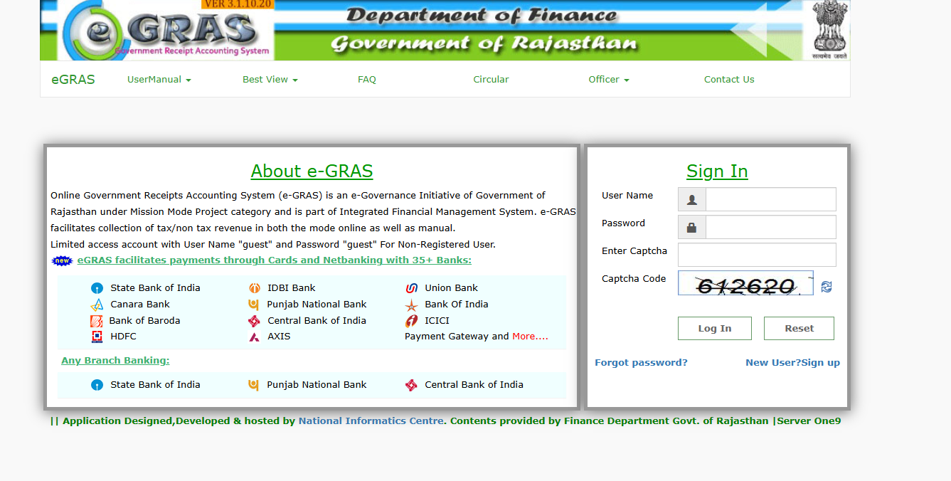
egrass.raj.gov.in

Slide 11
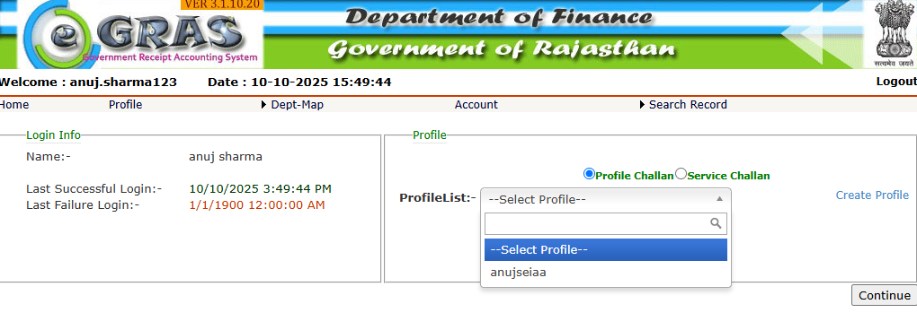
Login/Registration

Slide 12
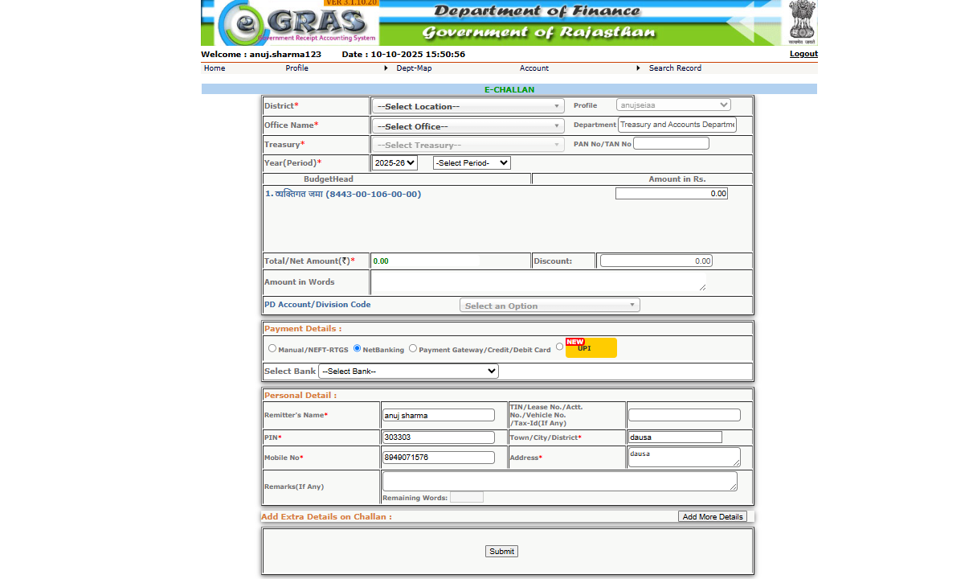

Slide 13
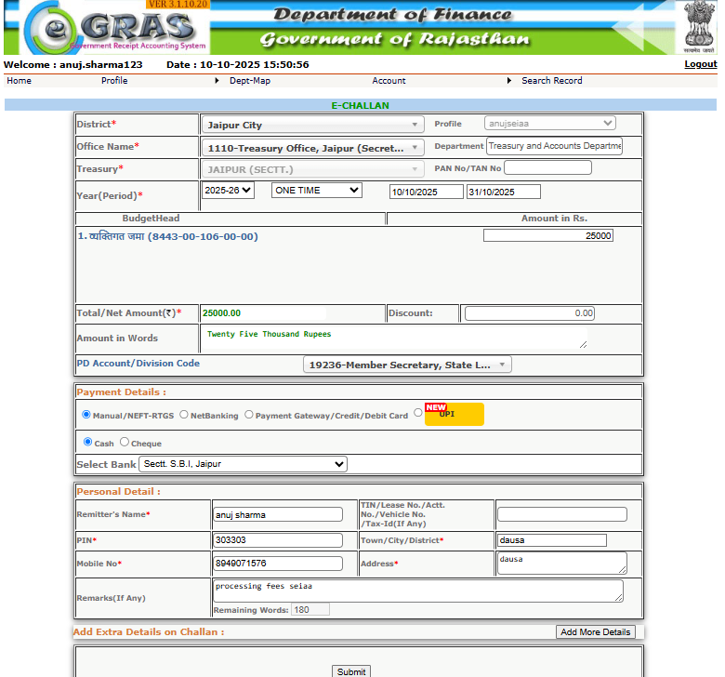

Slide 14
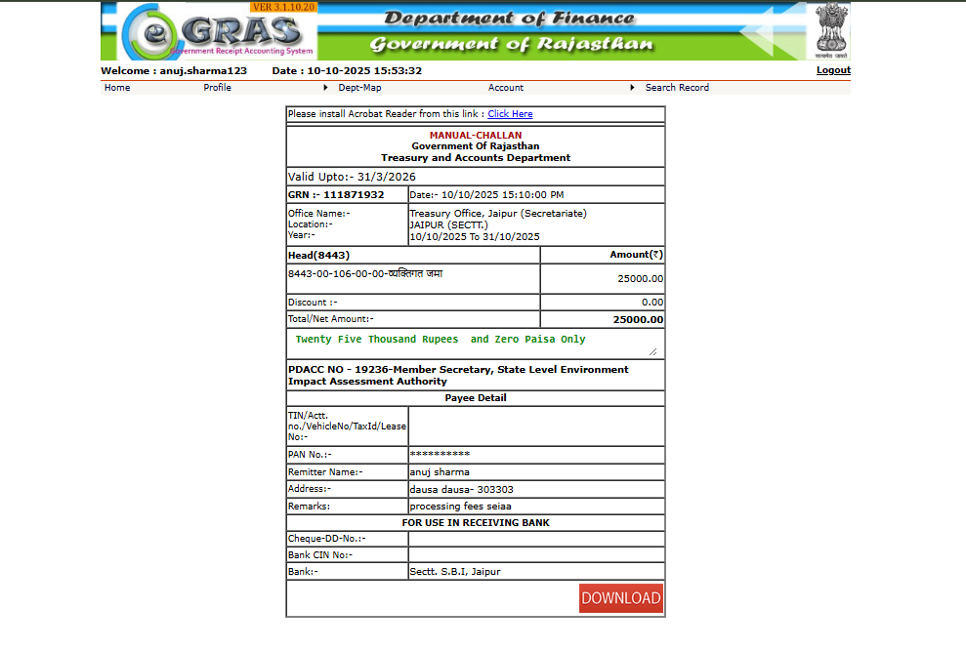
Download of fee submission

Slide 15
SEIAA HELPLINE NO :
0141-3500181
Thanks for Watching
For any details contact

